Slide 1
Linear Regression

Slide 2
Outline
Linear Regression
Most Important Variables
Assumption in linear Regression
Method for Dealing with Multicollinearity
Leverage and Influence
Handling Outlier data
Handling missing data
Case Study

Slide 3


Linear Regression (1)
Simple Linear Regression
Multiple Linear Regression

Slide 4
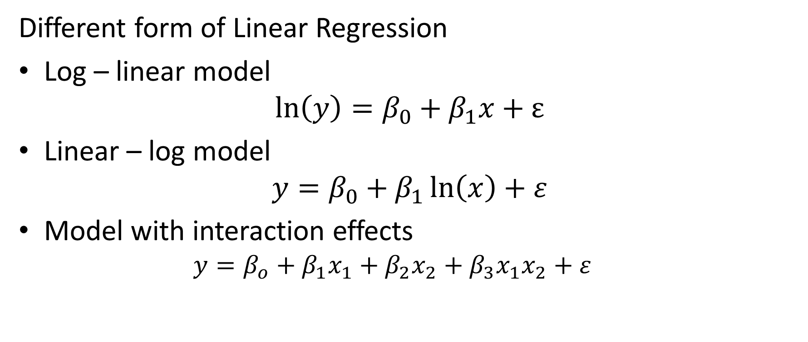
Linear Regression (2)
Different form of Linear Regression
Log – linear model
$$\ln\left(y\right)=β_{0}+β_{1}x+ε$$
Linear – log model
$$y=β_{0}+β_{1}\ln\left(x\right)+ε$$
Model with interaction effects
$$y=β_{o}+β_{1}x_{1}+β_{2}x_{2}+β_{3}x_{1}x_{2}+ε$$

Slide 5
Linear Regression (3)
Steps
Define the equation of regression model
Estimate the regression coefficient
Hypothesis testing (F test , t test)
Check the assumption of regression
Evaluate and interpret model
Use Model for Prediction and Estimation

Slide 6

Most Important Variables
See the correlation matrix of $X$ and $Y$
See the standardized regression coefficients
See the p-value of variable

Slide 7
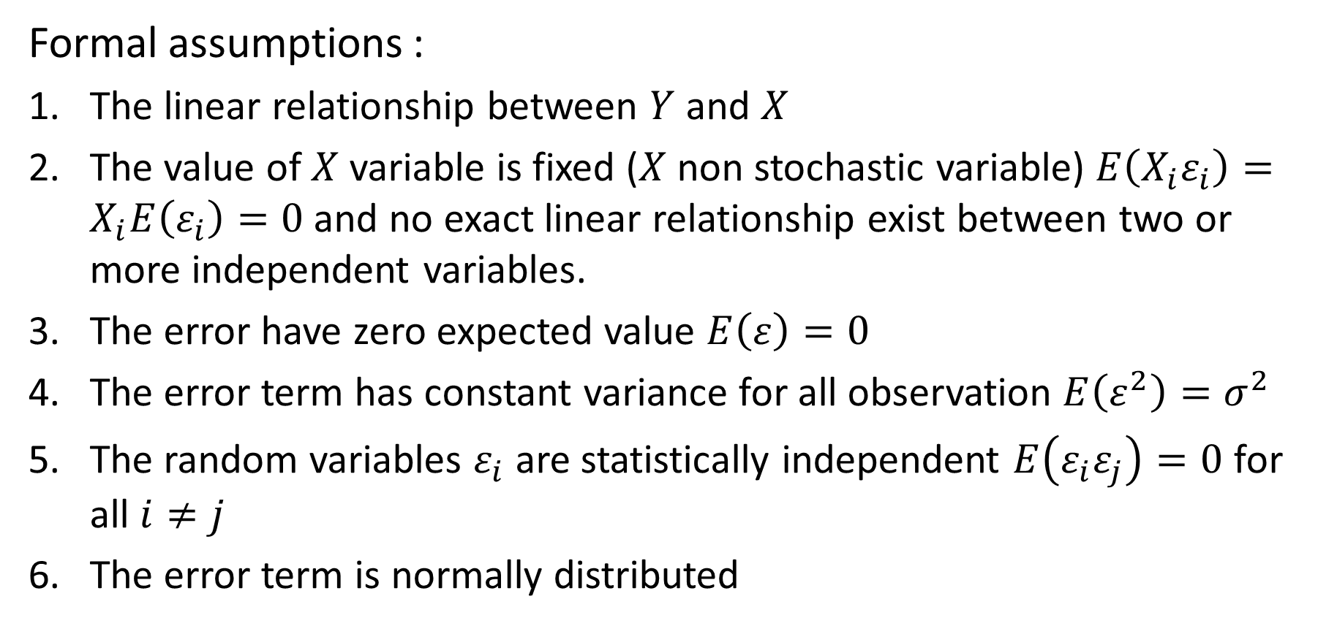
Assumption in linear Regression (1)
Formal assumptions :
The linear relationship between $Y$ and $X$
The value of $X$ variable is fixed ($X$ non stochastic variable) $E\left(X_{i}ε_{i}\right)=X_{i}E\left(ε_{i}\right)=0$ and no exact linear relationship exist between two or more independent variables.
The error have zero expected value $E\left(ε\right)=0$
The error term has constant variance for all observation $E\left(ε^{2}\right)=σ^{2}$
The random variables $ε_{i}$ are statistically independent $E\left(ε_{i}ε_{j}\right)=0$ for all $i≠j$
The error term is normally distributed

Slide 8
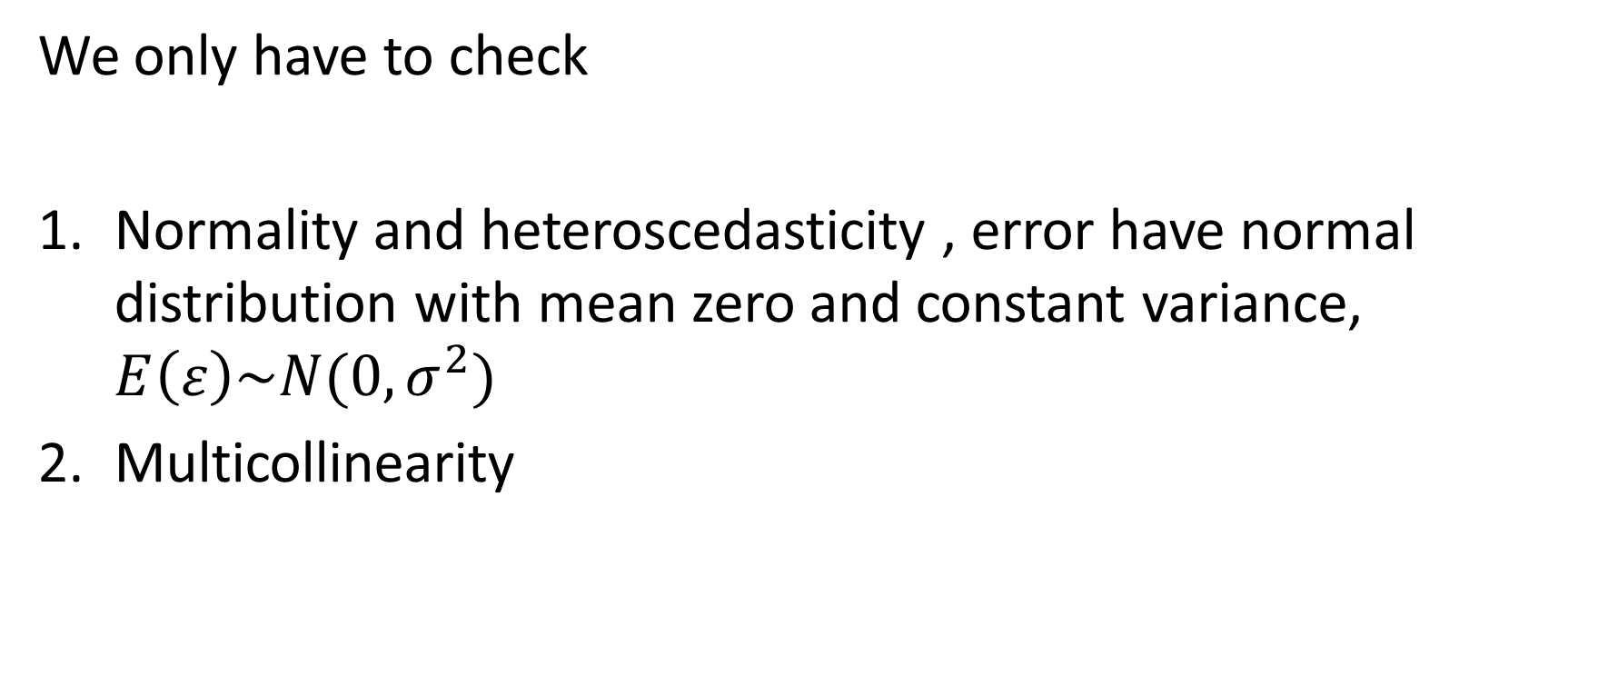
Assumption in linear Regression (2)
We only have to check
Normality and heteroscedasticity , error have normal distribution with mean zero and constant variance, $E\left(ε\right)\sim N(0,σ^{2})$
Multicollinearity

Slide 9
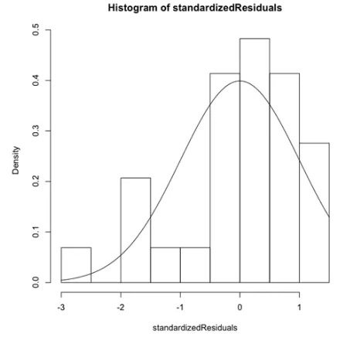
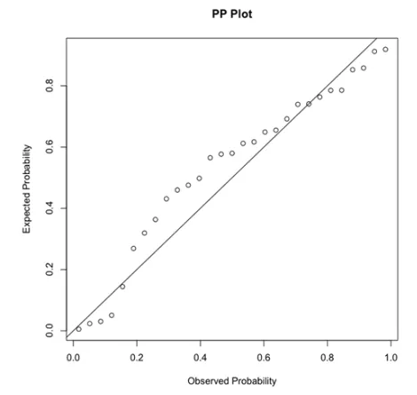
Check Normality (1)
Graphical
Histogram
Probability plot
create a probability plot
of error against normal
distribution
Notes:
https://www.r-bloggers.com/r-tutorial-series-graphic-analysis-of-regression-assumptions/

Slide 10
Check Normality (2)
Statistical testing
Jarque-Bera test
effective for skewness and kurtosis testing
Shapiro-Wilks test
not sensitive to problems in the tails
Kolmogorov-Smirnov test
Works best for data seta with <50, but can b used with larger data sets
D’Agostino test :
powerful omnibus (skewness, kurtosis, centrality) test
Notes:
http://webspace.ship.edu/pgmarr/Geo441/Lectures/Lec%205%20-%20Normality%20Testing.pdf

Slide 11
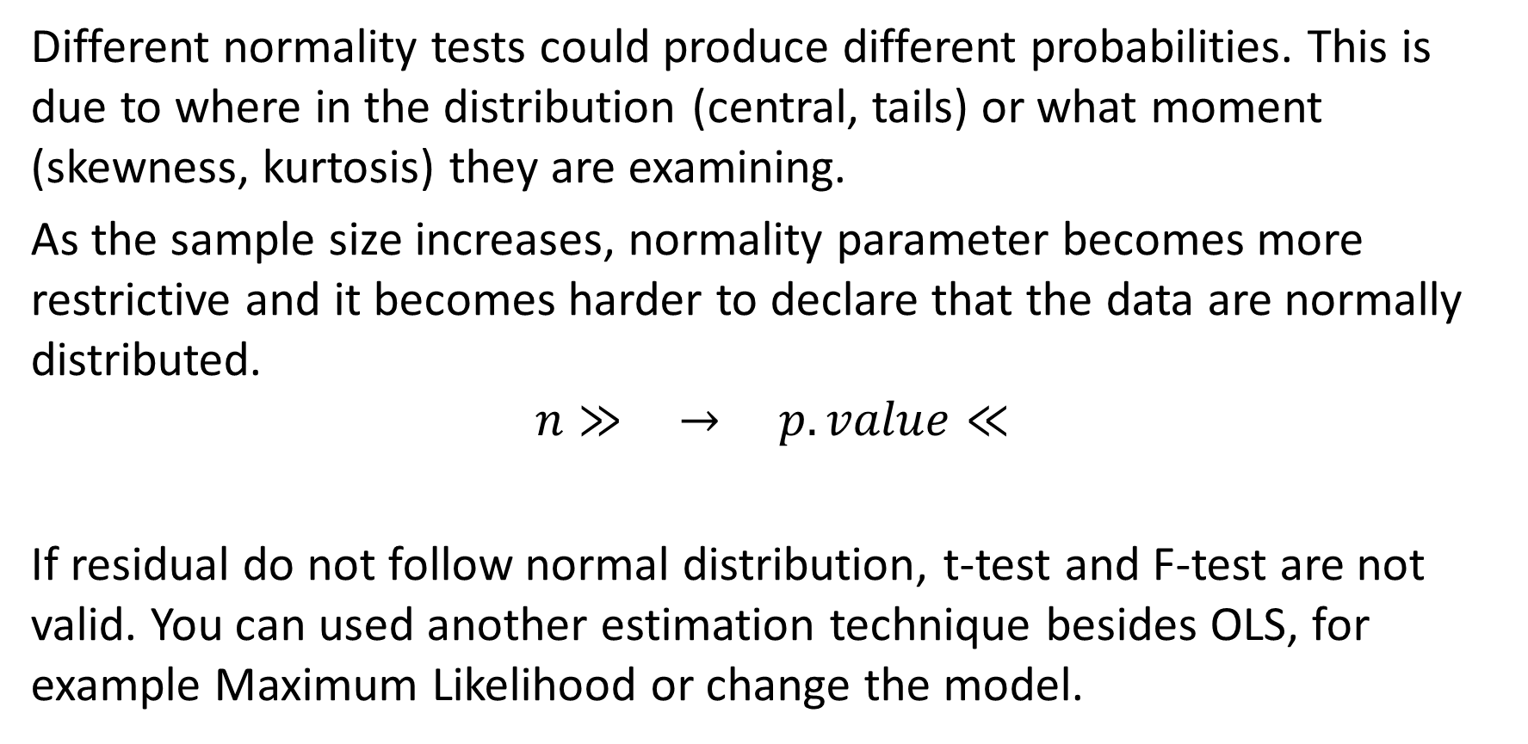
Check Normality (3)
Different normality tests could produce different probabilities. This is due to where in the distribution (central, tails) or what moment (skewness, kurtosis) they are examining.
As the sample size increases, normality parameter becomes more restrictive and it becomes harder to declare that the data are normally distributed.
$$n≫ → p.value≪$$
If residual do not follow normal distribution, t-test and F-test are not valid. You can used another estimation technique besides OLS, for example Maximum Likelihood or change the model.

Slide 12
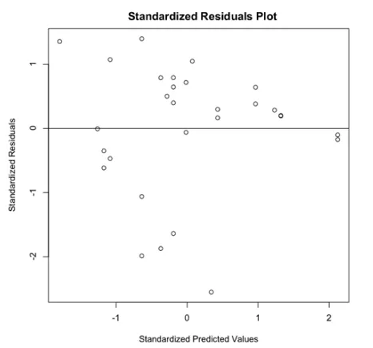
Check Heteroscedasticity (1)
Graphical
Standardized Residual plot
Notes:
https://www3.nd.edu/~rwilliam/stats2/l25.pdf

Slide 13
Check Heteroscedasticity (2)
Statistical testing
Breusch-Pagan Test
Only check the linear from heteroscedasticity
White Test
Can detect more general then Breusch-Pagan test
Notes:
https://www3.nd.edu/~rwilliam/stats2/l25.pdf

Slide 14


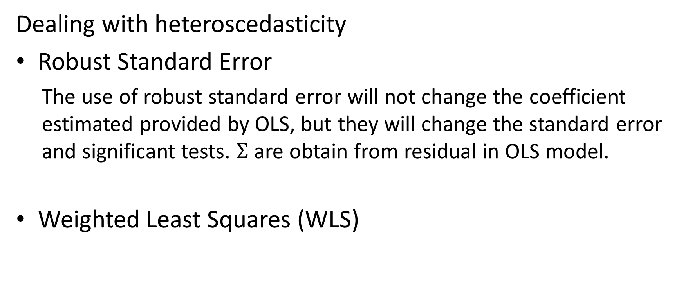
Check Heteroscedasticity (3)
Dealing with heteroscedasticity
Robust Standard Error
The use of robust standard error will not change the coefficient estimated provided by OLS, but they will change the standard error and significant tests. $Σ$ are obtain from residual in OLS model.
Weighted Least Squares (WLS)
Notes:
https://www3.nd.edu/~rwilliam/stats2/l25.pdf

Slide 15
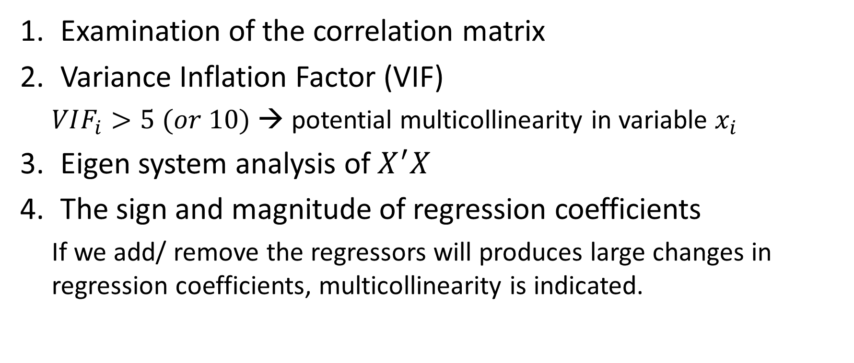
Check Multicollinearity
Examination of the correlation matrix
Variance Inflation Factor (VIF)
$VIF_{i}>5 (or 10)$ → potential multicollinearity in variable $x_{i}$
Eigen system analysis of $X^{′}X$
The sign and magnitude of regression coefficients
If we add/ remove the regressors will produces large changes in regression coefficients, multicollinearity is indicated.

Slide 16
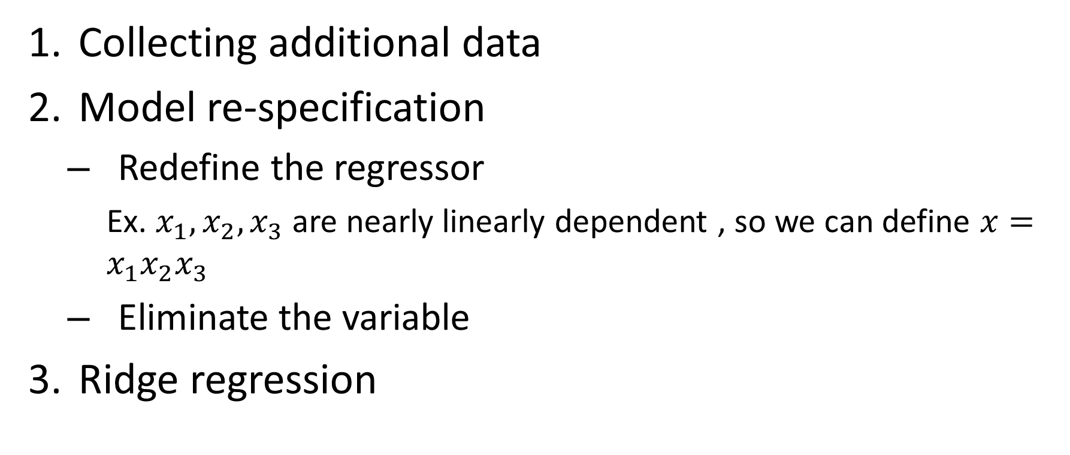
Method for Dealing with Multicollinearity
Collecting additional data
Model re-specification
Redefine the regressor
Ex. $x_{1},x_{2},x_{3}$ are nearly linearly dependent , so we can define $x=x_{1}x_{2}x_{3}$
Eliminate the variable
Ridge regression

Slide 17
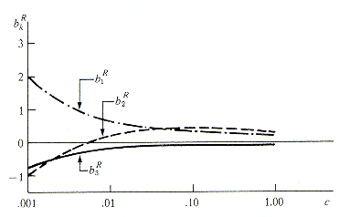
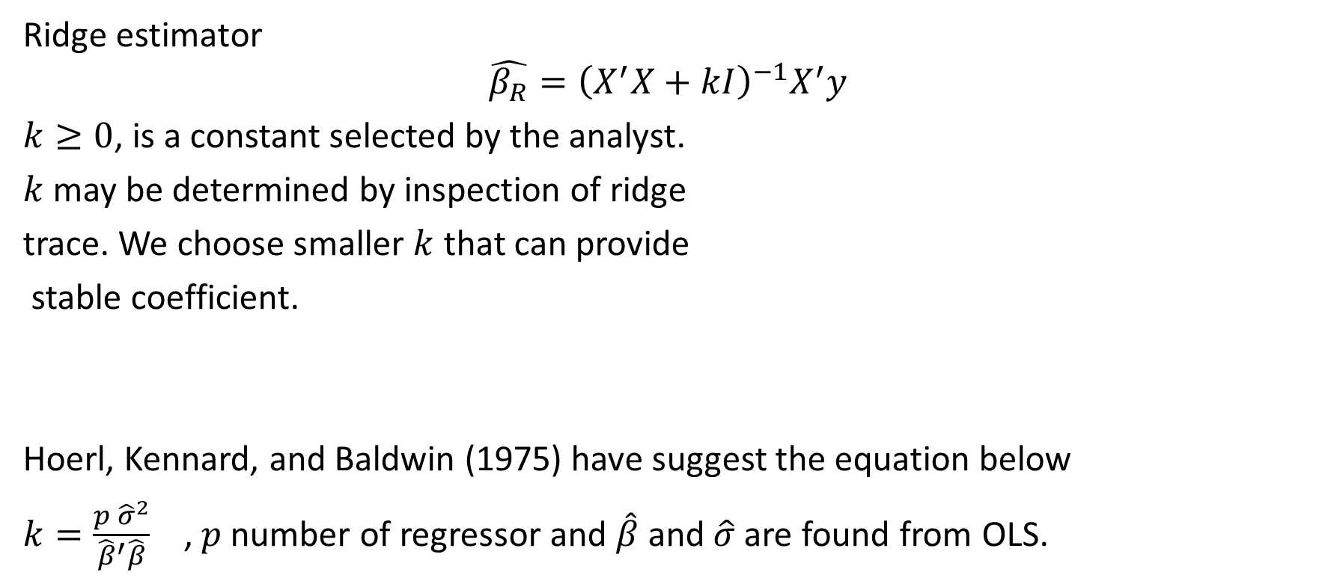
Ridge regression
Ridge estimator
$$\hat{β_{R}}={\left(X^{′}X+kI\right)}^{−1}X^{′}y$$
$k≥0$, is a constant selected by the analyst.
$k$ may be determined by inspection of ridge
trace. We choose smaller $k$ that can provide
stable coefficient.
Hoerl, Kennard, and Baldwin (1975) have suggest the equation below
$k=\frac{p {\hat{σ}}^{2}}{{\hat{β}}^{′}\hat{β}}$ , $p$number of regressor and $\hat{β}$ and $\hat{σ}$are found from OLS.

Slide 18
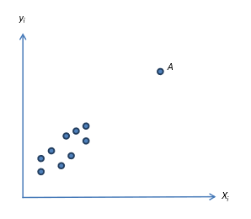
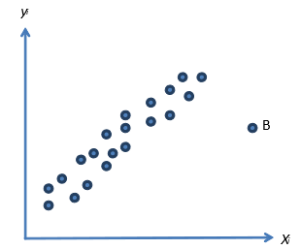

Leverage and Influence (1)
Leverage
Point A does not effect the estimates of regression coefficient but it effect the model summary ($R^{2}$, standard error of regression coefficient etc.)
Influence
Point B has noticeable impact on the model coefficient. If the influential point are indeed “bad” value, then they should be eliminated from the sample.

Slide 19

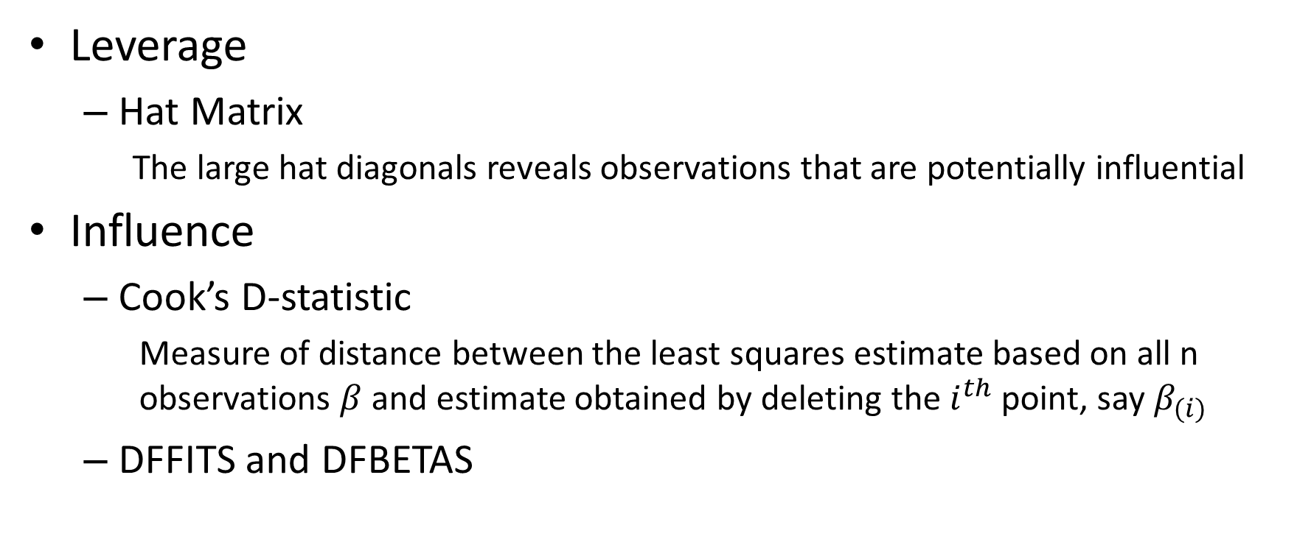
Leverage and Influence (2)
Leverage
Hat Matrix
The large hat diagonals reveals observations that are potentially influential
Influence
Cook’s D-statistic
Measure of distance between the least squares estimate based on all n observations $β$ and estimate obtained by deleting the $i^{th}$ point, say $β_{(i)}$
DFFITS and DFBETAS

Slide 20
Handling Outlier Data
If it is obvious that the outlier is due to incorrectly entered or measured data, you should drop the outlier
If the outlier does not change the results but does affect assumptions, you may drop the outlier. But note that in a footnote of your paper.
More commonly, the outlier affects both results and assumptions. In this situation, it is not legitimate to simply drop the outlier. You may run the analysis both with and without it, but you should state in at least a footnote the dropping of any such data points and how the results changed.
If the outlier creates a significant association, you should drop the outlier and should not report any significance from your analysis.

Slide 21
Handling Missing Data
Delete all data from any observation with missing values
Dropping variables, you can drop the variables if the data is missing for more than 60% observations but only if that variables is insignificant.
Average imputation, use the average of completed data to fill the missing value
Regression substitution, use multiple regression to estimate a missing value
K Nearest Neighbors, k neighbors are chosen based on some distance measure and their average is used as an imputation estimate.

Slide 22
Case Study
Relationship between product revenue and user behavior (product view, add to cart, etc.)
yitemrevenue – Item Revenue at Rs
xcartadd – Numbers of instance added to cart
xcartuniqadd – Numbers of unique instance added to cart
xcartaddtotalrs –Total Rs value of products after they are added to cart
xcartremove- Numbers of instances removed from cart
xcardtremovetotal – Total numbers of instances removed from cart
xcardtremovetotalrs – Total Rs after numbers of instances removed from cart
xproductviews – Numbers of page views
xuniqprodview – Numbers of unique product views
xprodviewinrs – Rs at total numbers of page
Notes:
https://www.tatvic.com/blog/product-revenue-prediction-with-r/?utm_source=copytext&utm_medium=text&utm_campaign=textshare

Slide 23
Case Study- Relationship between product revenue and user behavior
Data explanatory – outlier detection
Summary(data)
hist(data$yitemrevenue, breaks = 100)
Create newdata : remove the outlier
newdata <- subset(data,yitemrevenue<10000)
summary(newdata)
Linear model
model=lm(yitemrevenue~.,data=data)
model_out=lm(yitemrevenue~.,data=newdata)

Slide 24
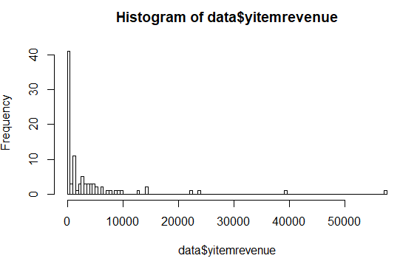
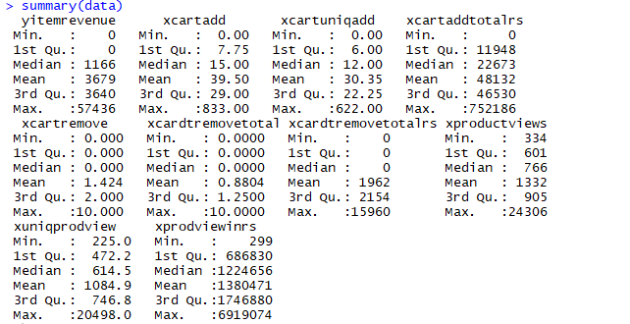

Slide 25
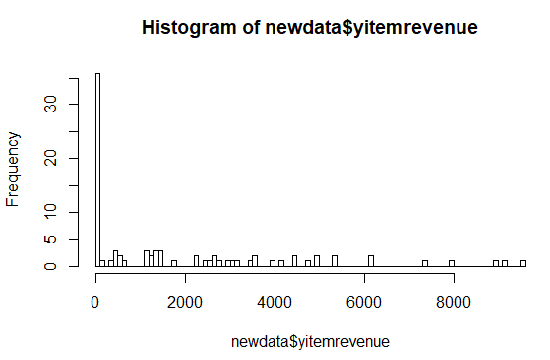
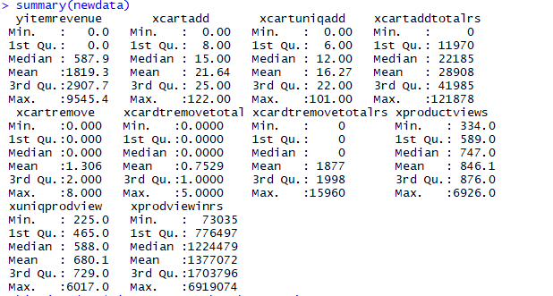

Slide 26
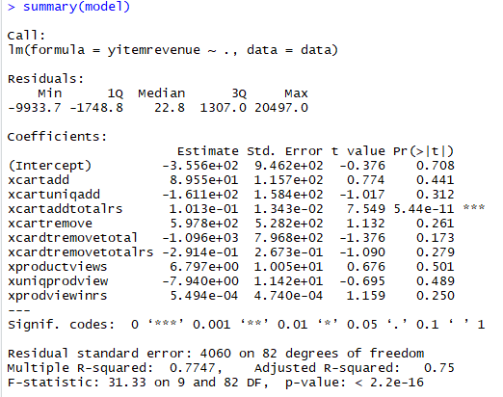
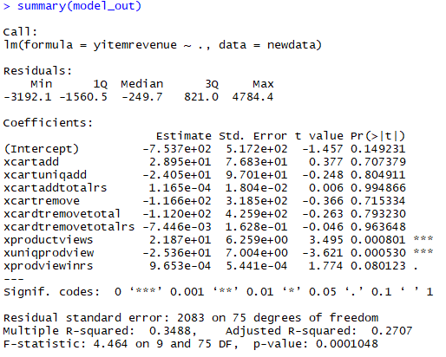
By using full data we have higher R-squared

Slide 27
Check the assumption
#heteroscedaticity
unstandardizedPredicted <- predict(model)
unstandardizedResiduals <- resid(model)
standardizedPredicted <- (unstandardizedPredicted - mean(unstandardizedPredicted)) / sd(unstandardizedPredicted)
standardizedResiduals <- (unstandardizedResiduals - mean(unstandardizedResiduals)) / sd(unstandardizedResiduals)
plot(standardizedPredicted, standardizedResiduals, main = "Standardized Residuals Plot", xlab = "Standardized Predicted Values", ylab = "Standardized Residuals")
abline(0,0)
#normality
probDist <- pnorm(standardizedResiduals)
plot(ppoints(length(standardizedResiduals)), sort(probDist), main = "PP Plot", xlab = "Observed Probability", ylab = "Expected Probability")
abline(0,1)

Slide 28
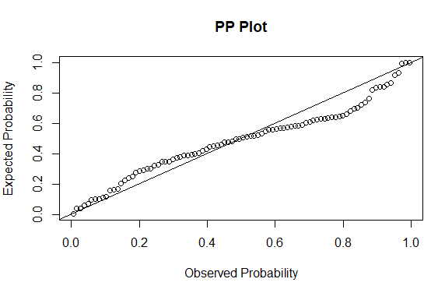
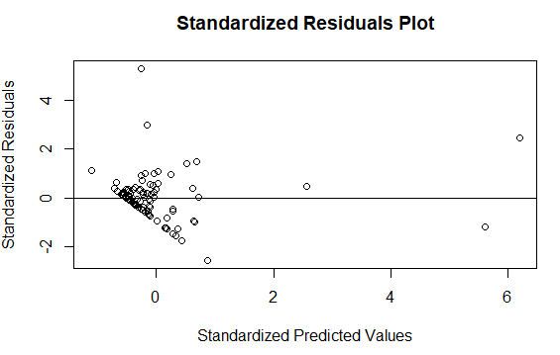
The graph show that heteroscedaticity indication
The residual tend to have normal distribution.

Slide 29
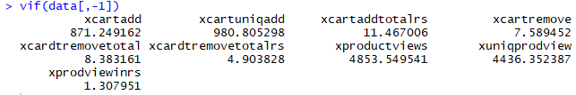

Check the assumption
#multicolinearity
vif<- function(xx,y.name,na.action=na.exclude,...){
nnames<-names(xx)
nn.x<-seq(along=nnames)
if(missing(y.name))
y.number<-0
else{
y.number<- match (y.name,nnames,0)
nn.x<-nn.x[-y.number]
}
r2<-nn.x
names(r2)<-nnames[nn.x]
if(length(r2)<2) stop("vif requares two or more x variables")
for (i in nn.x){
tmp.lm<-lm(xx[,i]~data.matrix(xx[,-c(y.number,i)]),
na.action=na.action)
r2[nnames[i]]<-summary(tmp.lm)$r.squared
}
1/(1-r2)
}
vif(data[,-1])

Slide 30
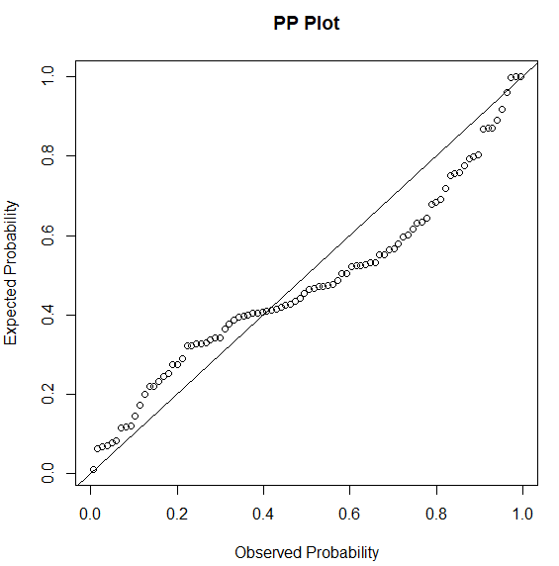
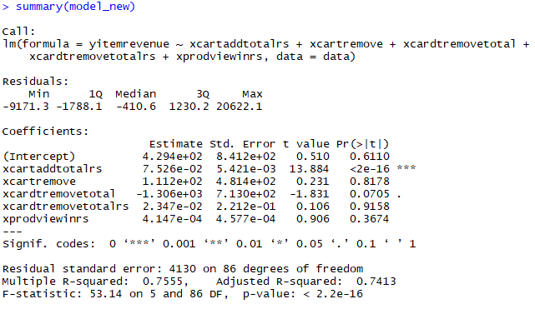
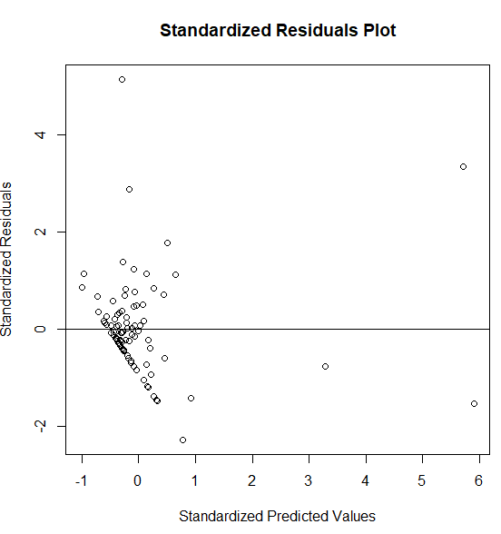
Re-Specification model
Model did not fulfill the assumption

Slide 31
Non Linear Regression

Slide 32
Outline
Non Linear Regression Model
Non Linear Least Square
Transformation to a Linear Model
Parameter Estimation in a Non Linear System
Statistical Inference in Non Linear Regression
Growth Model and Compartment Model
Non Linear Mixed-Effect Model
Non-Parametric : MARS
Case Study

Slide 33
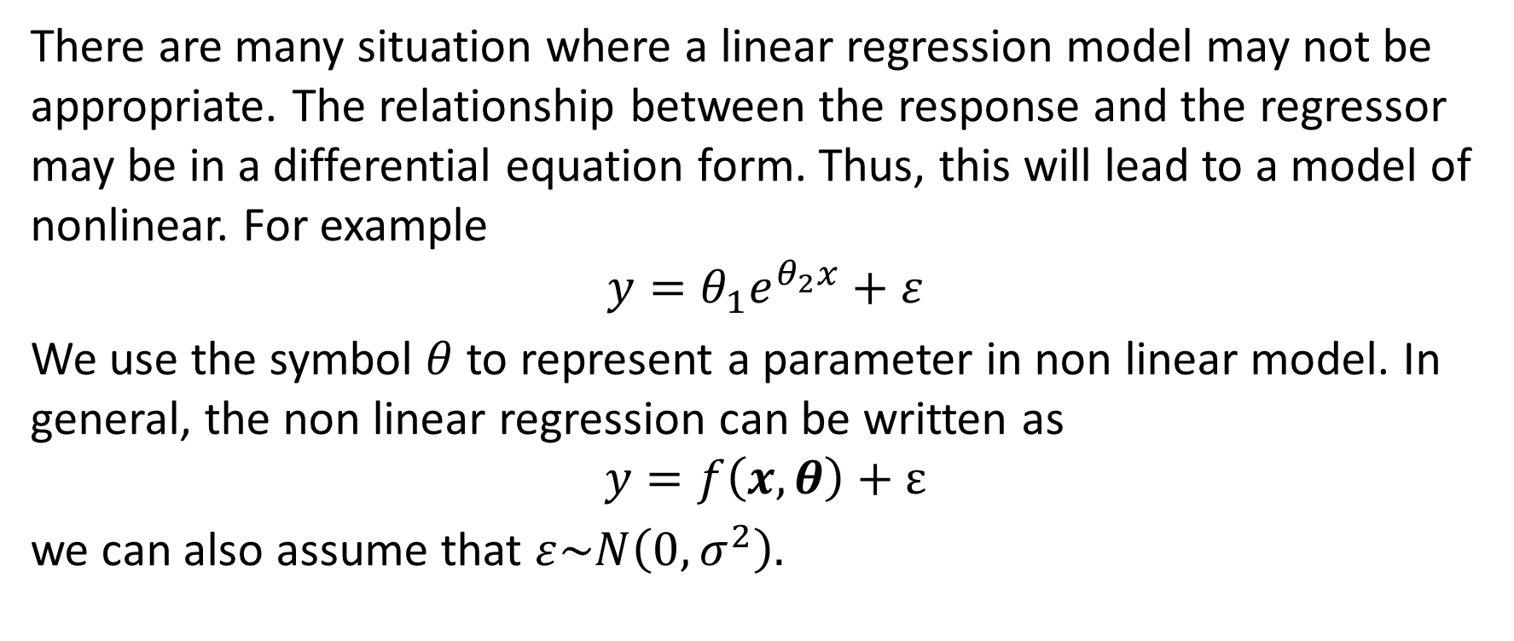
Non Linear Regression Model (1)
There are many situation where a linear regression model may not be appropriate. The relationship between the response and the regressor may be in a differential equation form. Thus, this will lead to a model of nonlinear. For example
$$y=θ_{1}e^{θ_{2}x}+ε$$
We use the symbol $θ$ to represent a parameter in non linear model. In general, the non linear regression can be written as
$$y=f\left(x,θ\right)+ε$$
we can also assume that $ε\sim N\left(0,σ^{2}\right).$

Slide 34
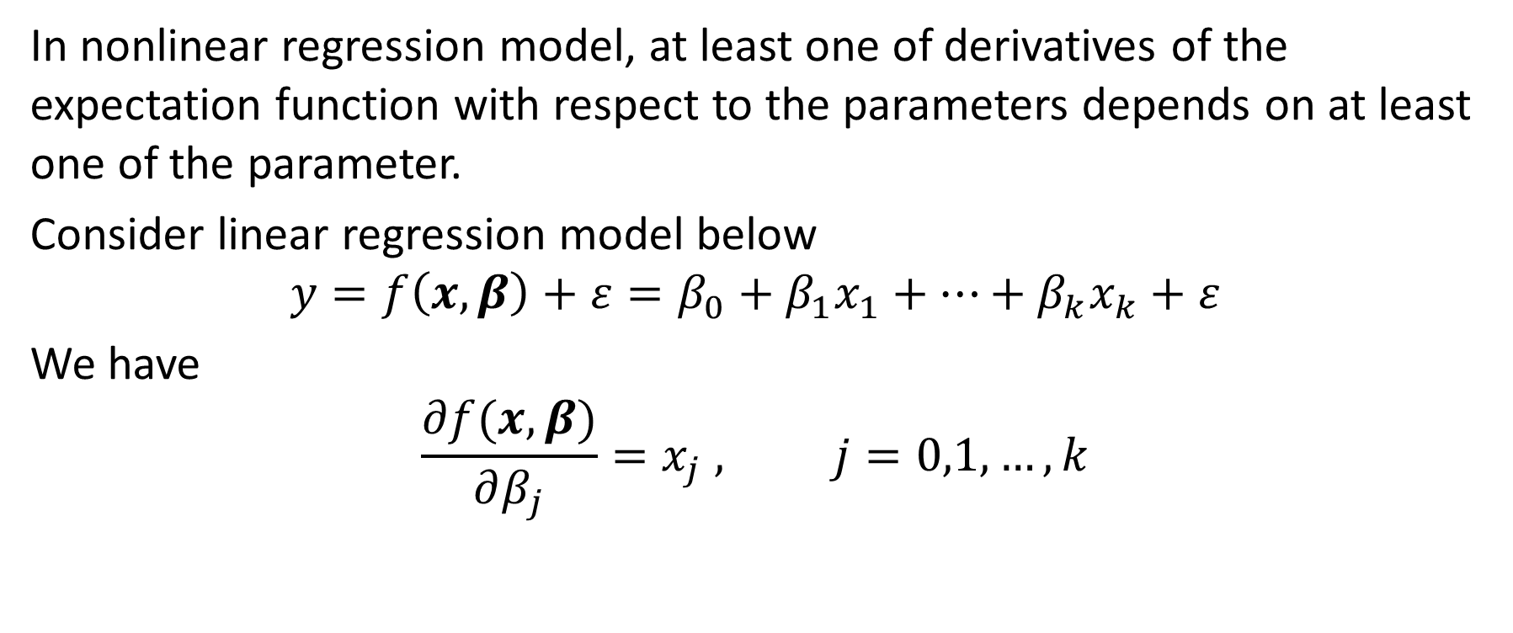
Non Linear Regression Model (2)
In nonlinear regression model, at least one of derivatives of the expectation function with respect to the parameters depends on at least one of the parameter.
Consider linear regression model below
$$y=f\left(x,β\right)+ε=β_{0}+β_{1}x_{1}+…+β_{k}x_{k}+ε$$
We have
$$\frac{∂f(x,β)}{∂β_{j}}=x_{j} , j=0,1,…,k$$

Slide 35
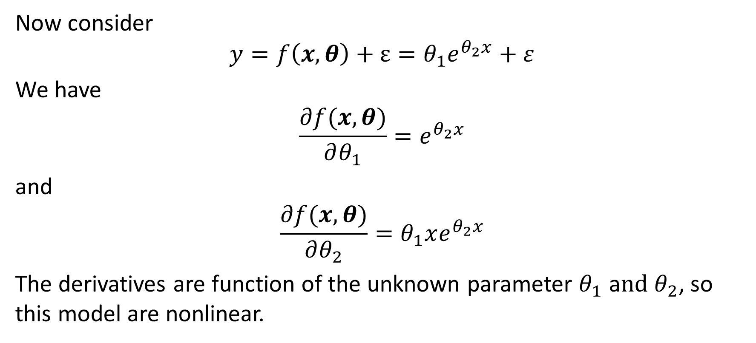
Non Linear Regression Model (3)
Now consider
$$y=f\left(x,θ\right)+ε=θ_{1}e^{θ_{2}x}+ε$$
We have
$$\frac{∂f(x,θ)}{∂θ_{1}}=e^{θ_{2}x}$$
and
$$\frac{∂f(x,θ)}{∂θ_{2}}=θ_{1}xe^{θ_{2}x}$$
The derivatives are function of the unknown parameter $θ_{1}$ a$nd θ_{2}$, so this model are nonlinear.

Slide 36
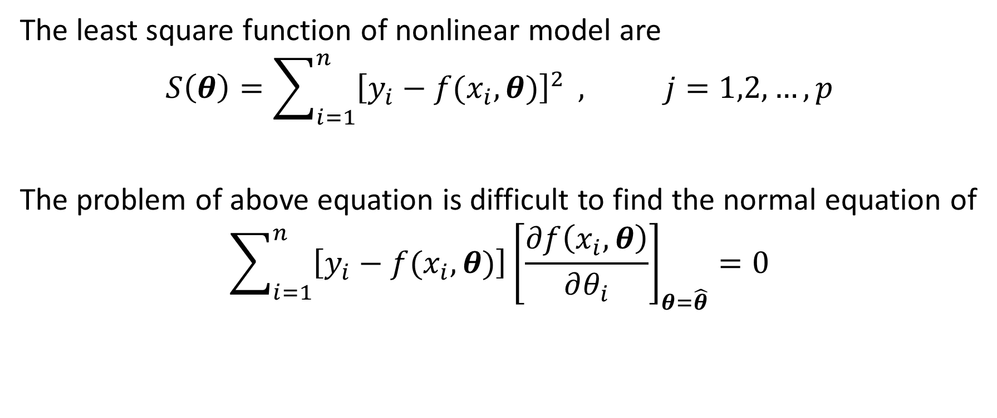
Non Linear Least Square (1)
The least square function of nonlinear model are
$$S\left(θ\right)=\sum_{i=1}^{n}{{\left[y_{i}−f(x_{i},θ)\right]}^{2}} , j=1,2,…, p$$
The problem of above equation is difficult to find the normal equation of
$$\sum_{i=1}^{n}{\left[y_{i}−f(x_{i},θ)\right]}{\left[\frac{∂f\left(x_{i},θ\right)}{∂θ_{i}}\right]}_{θ=\hat{θ}}=0$$

Slide 37
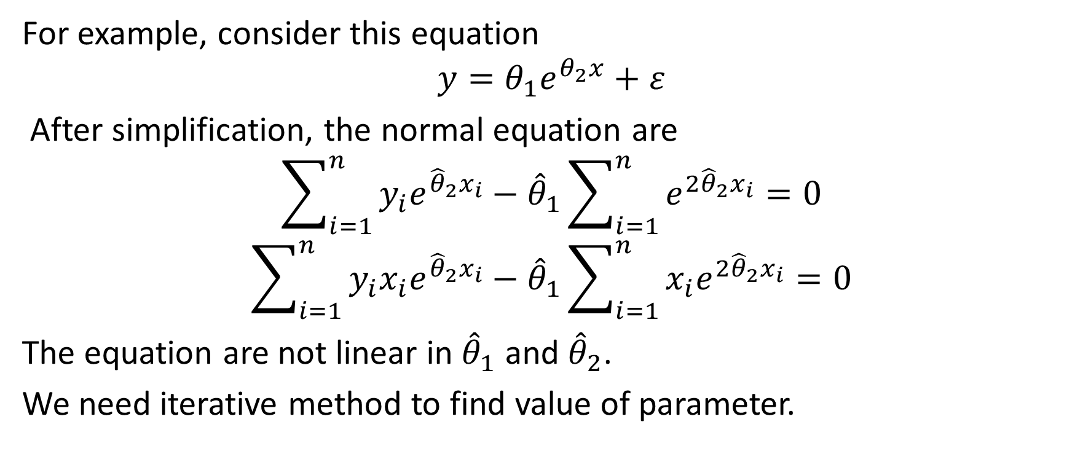
Non Linear Least Square (2)
For example, consider this equation
$$y=θ_{1}e^{θ_{2}x}+ε$$
After simplification, the normal equation are
$$\sum_{i=1}^{n}{y_{i}e^{{\hat{θ}}_{2}x_{i}}}−{\hat{θ}}_{1}\sum_{i=1}^{n}{e^{2{\hat{θ}}_{2}x_{i}}}=0$$
$$\sum_{i=1}^{n}{y_{i}x_{i}e^{{\hat{θ}}_{2}x_{i}}}−{\hat{θ}}_{1}\sum_{i=1}^{n}{{x_{i}e}^{2{\hat{θ}}_{2}x_{i}}}=0$$
The equation are not linear in ${\hat{θ}}_{1}$ and ${\hat{θ}}_{2}$.
We need iterative method to find value of parameter.

Slide 38
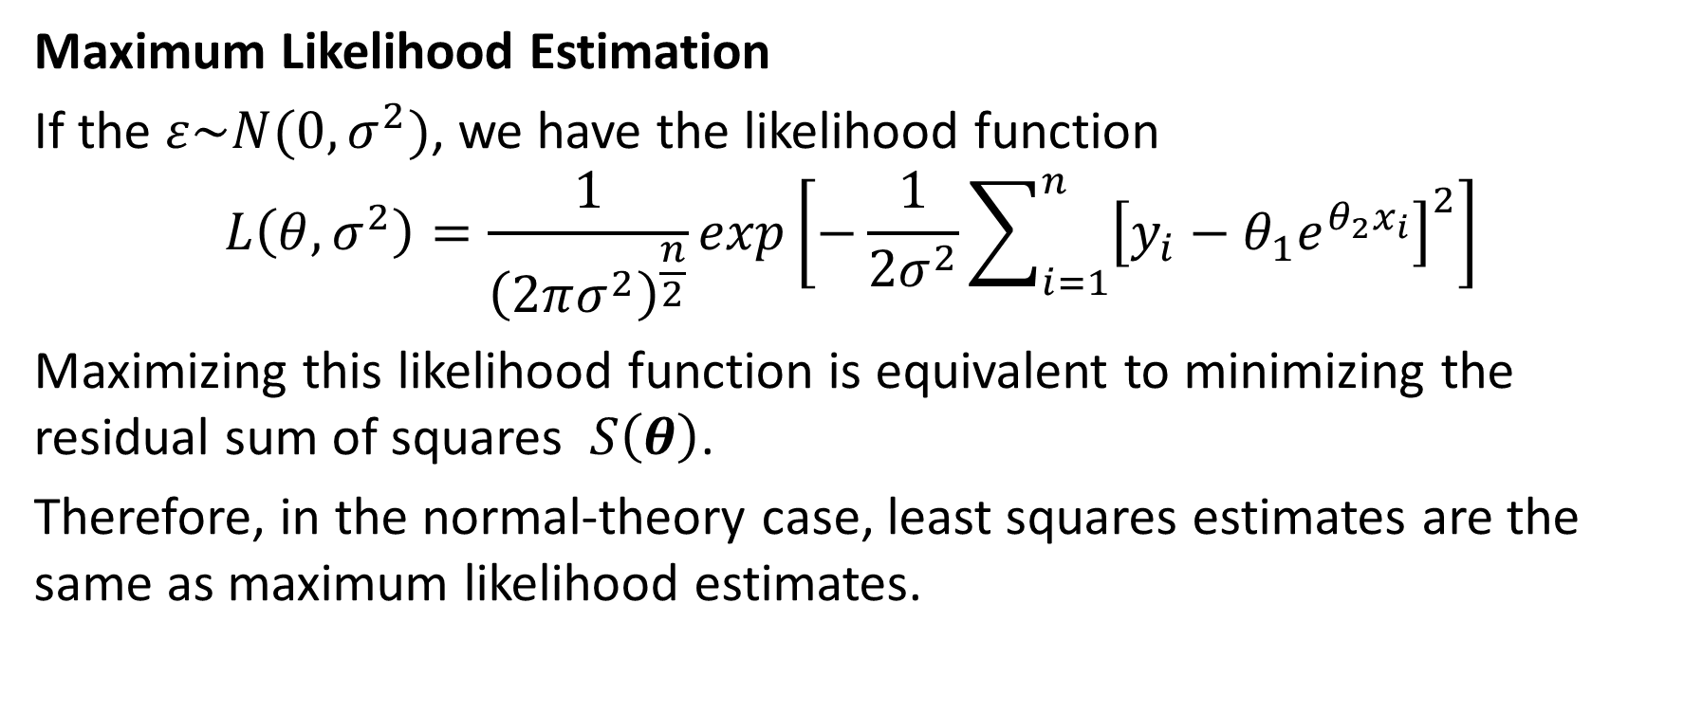
Non Linear Least Square (3)
Maximum Likelihood Estimation
If the $ε\sim N(0,σ^{2})$, we have the likelihood function
$$L\left(θ,σ^{2}\right)=\frac{1}{{\left(2πσ^{2}\right)}^{\frac{n}{2}}}exp\left[−\frac{1}{2σ^{2}}\sum_{i=1}^{n}{{\left[y_{i}−θ_{1}e^{θ_{2}x_{i}}\right]}^{2}}\right]$$
Maximizing this likelihood function is equivalent to minimizing the residual sum of squares $S\left(θ\right)$.
Therefore, in the normal-theory case, least squares estimates are the same as maximum likelihood estimates.

Slide 39
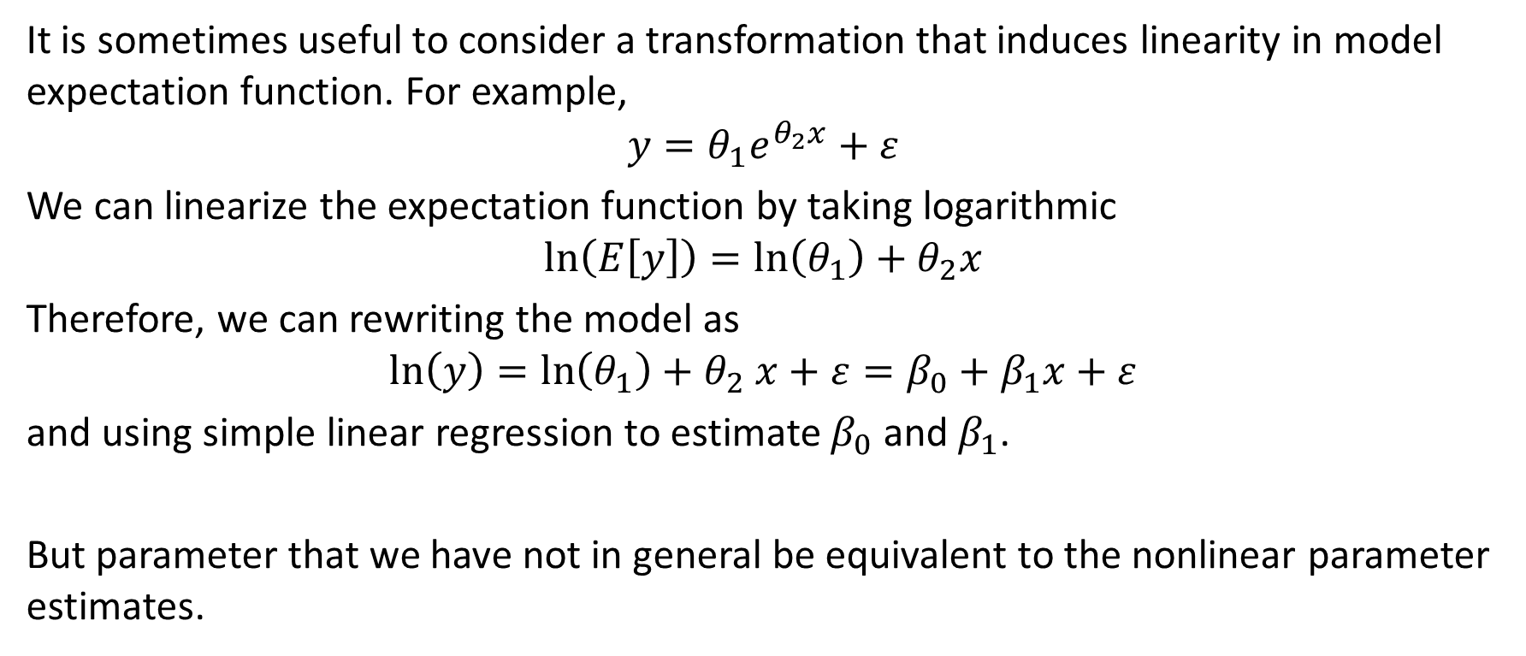
Transformation to a Linear Model
It is sometimes useful to consider a transformation that induces linearity in model expectation function. For example,
$$y=θ_{1}e^{θ_{2}x}+ε$$
We can linearize the expectation function by taking logarithmic
$$\ln\left(E\left[y\right]\right)=\ln\left(θ_{1}\right)+θ_{2}x$$
Therefore, we can rewriting the model as
$$\ln\left(y\right)=\ln\left(θ_{1}\right)+θ_{2} x+ε=β_{0}+β_{1}x+ε$$
and using simple linear regression to estimate $β_{0}$ and $β_{1}$.
But parameter that we have not in general be equivalent to the nonlinear parameter estimates.

Slide 40
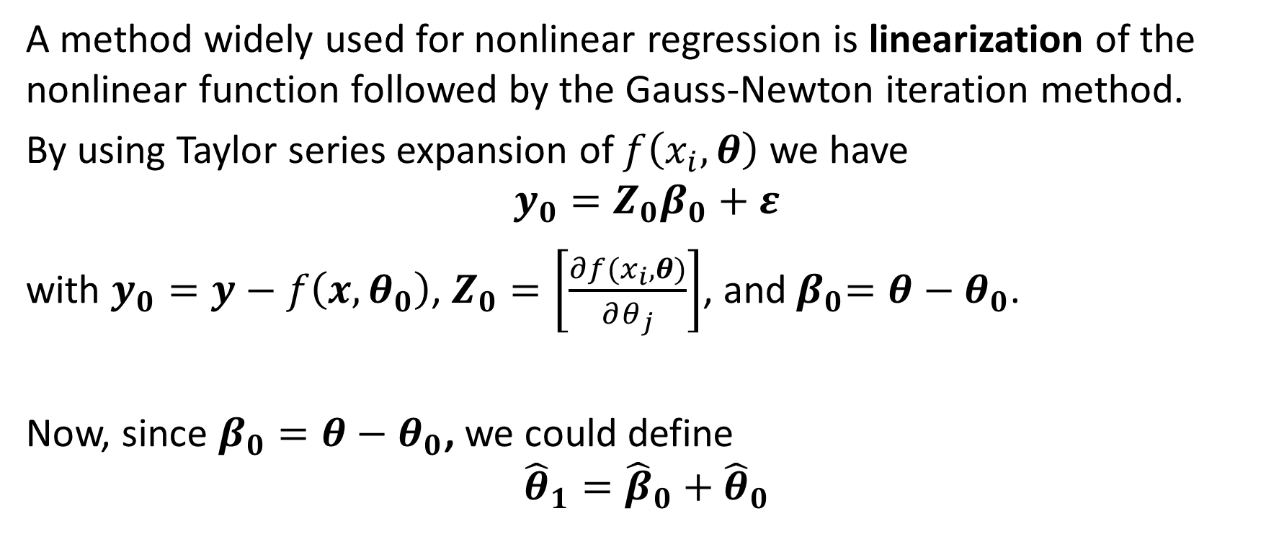
Parameter Estimation in a Non Linear System (1)
A method widely used for nonlinear regression is linearization of the nonlinear function followed by the Gauss-Newton iteration method.
By using Taylor series expansion of $f\left(x_{i}, θ\right)$ we have
$$y_{0}=Z_{0}β_{0}+ε$$
with $y_{0}=y−f\left(x,θ_{0}\right)$, $Z_{0}=\left[\frac{∂f(x_{i},θ)}{∂θ_{j}}\right]$, and${ β}_{0}=θ−θ_{0}$.
Now, since $β_{0}=θ−θ_{0}$, we could define
$${\hat{θ}}_{1}={\hat{β}}_{0}+{\hat{θ}}_{0}$$

Slide 41
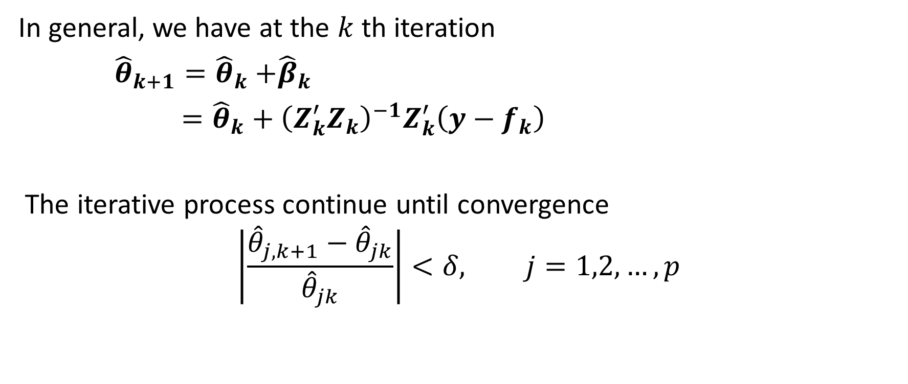
Parameter Estimation in a Non Linear System (2)
In general, we have at the $k$ th iteration
${\hat{θ}}_{k+1}={\hat{θ}}_{k}{+\hat{β}}_{k}$
$={\hat{θ}}_{k}+{\left(Z_{k}^{′}Z_{k}\right)}^{−1}Z_{k}^{′}\left(y−f_{k}\right)$
The iterative process continue until convergence
$$\left|\frac{{\hat{θ}}_{j,k+1}−{\hat{θ}}_{jk}}{{\hat{θ}}_{jk}}\right|<δ, j=1,2,…,p$$

Slide 42
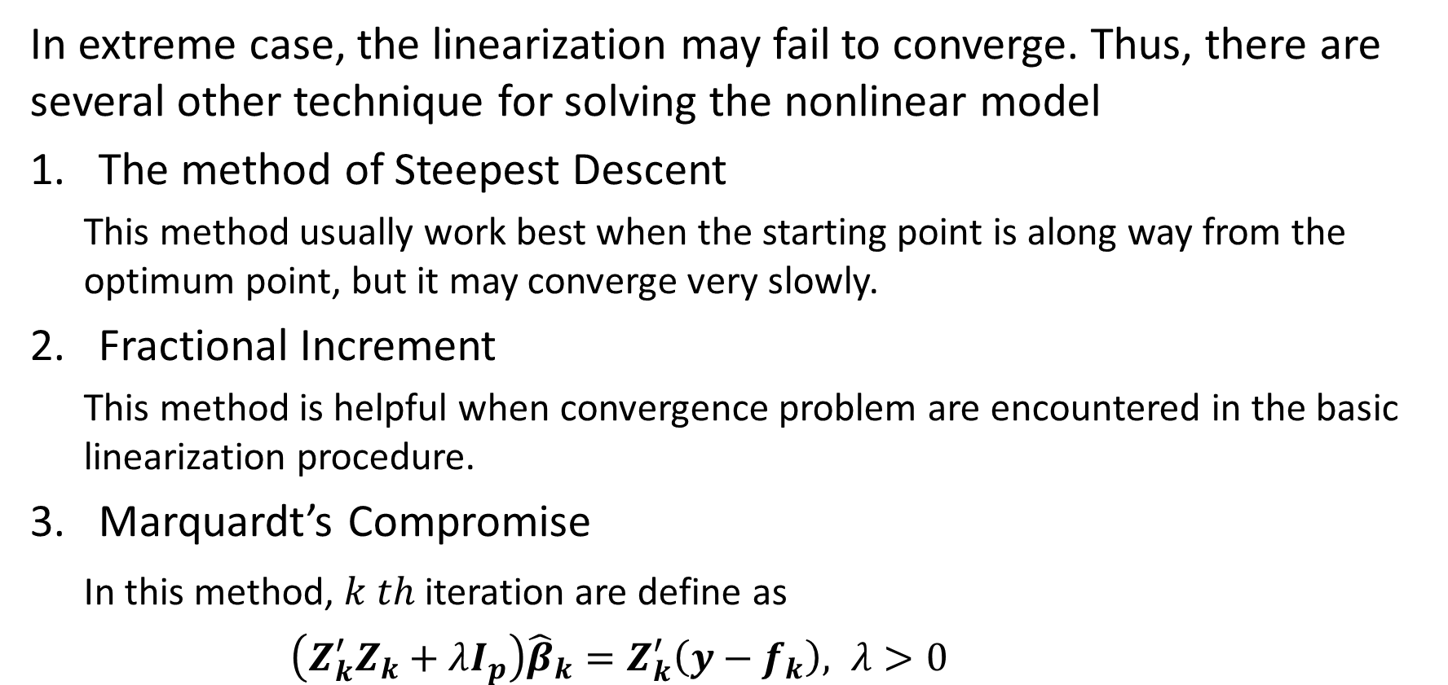
Parameter Estimation in a Non Linear System (3)
In extreme case, the linearization may fail to converge. Thus, there are several other technique for solving the nonlinear model
The method of Steepest Descent
This method usually work best when the starting point is along way from the optimum point, but it may converge very slowly.
Fractional Increment
This method is helpful when convergence problem are encountered in the basic linearization procedure.
Marquardt’s Compromise
In this method, $k th$iteration are define as
$\left(Z_{k}^{′}Z_{k}+λI_{p}\right){\hat{β}}_{k}=Z_{k}^{′}\left(y−f_{k}\right), λ>0$

Slide 43
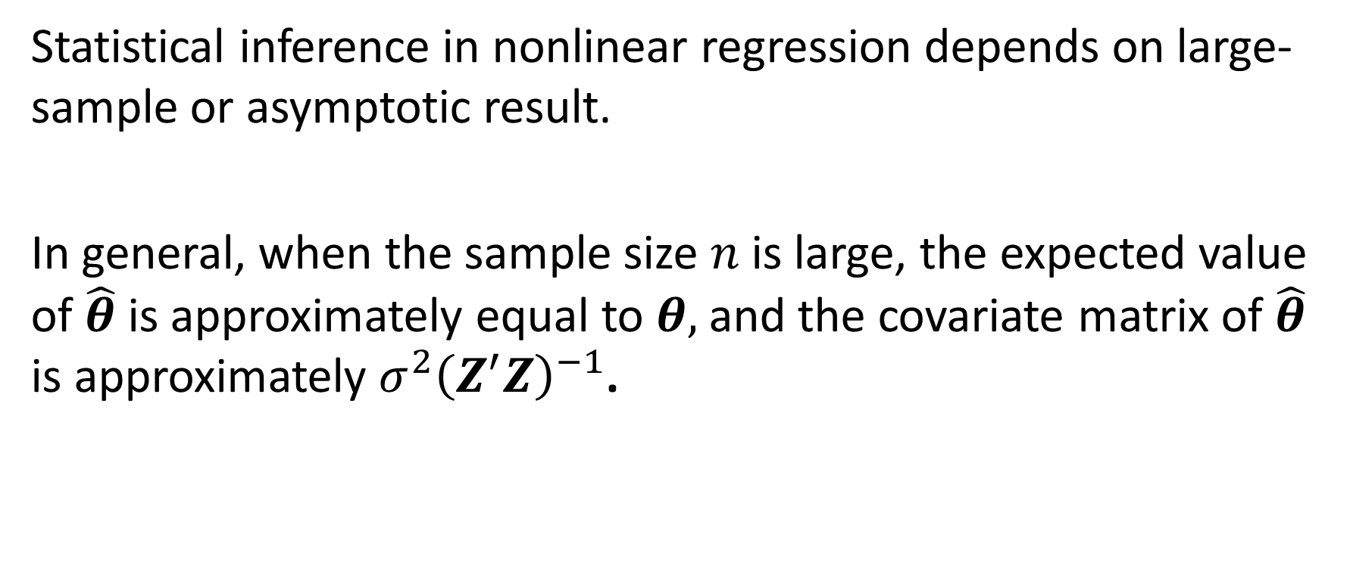
Statistical Inference in Non Linear Regression (1)
Statistical inference in nonlinear regression depends on large-sample or asymptotic result.
In general, when the sample size $n$ is large, the expected value of $\hat{θ}$ is approximately equal to $θ,$ and the covariate matrix of $\hat{θ}$ is approximately $σ^{2}{\left(Z^{′}Z\right)}^{−1}$.

Slide 44
Statistical Inference in Non Linear Regression (2)
There are some indicator that the result of nonlinear regression may be valid in a particular application
If the nonlinear regression estimation algorithm converges in only a few iterations, then this indicates the linear approximation was satisfactory.
The similar result in bootstrap sampling distribution of estimator and estimator produced by the asymptotic result, indicates that the large-samples inference results are valid.

Slide 45
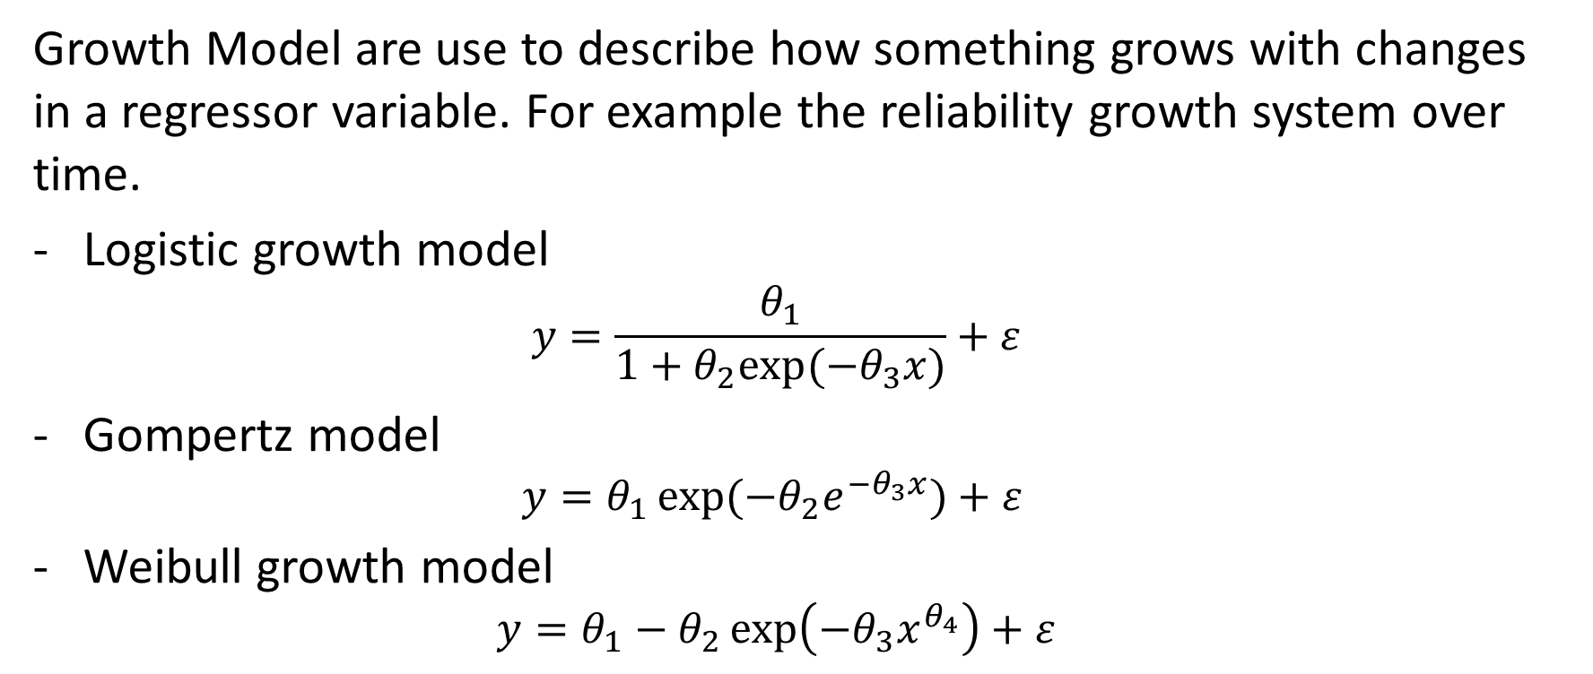
Growth Model and Compartment Model (1)
Growth Model are use to describe how something grows with changes in a regressor variable. For example the reliability growth system over time.
Logistic growth model
$$y=\frac{θ_{1}}{1+θ_{2}exp⁡(−θ_{3}x)}+ε$$
Gompertz model
$$y=θ_{1}\exp{(−θ_{2}e^{−θ_{3}x}})+ε$$
Weibull growth model
$$y=θ_{1}−θ_{2}\exp\left(−θ_{3}x^{θ_{4}}\right)+ε$$

Slide 46
Growth Model and Compartment Model (2)
Compartmental models are mechanistic models where one or more measurements of some physical process is related to time, inputs to the system, and other explanatory variables through a compartmental system.
Compartmental models are common in chemical kinetics, toxicology, hydrology, geology, and pharmacokinetics.

Slide 47
Non Linear Mixed-Effect Model
Nonlinear mixed-effect models (NLMMs) are extended of linear mixed-effect models (LMMs). NLMMs are the nonlinear regression that used in longitudinal data that allow both fixed and random effects.
Mixed-effects models can represent the covariance structure related to the grouping of data by associating the common random effects to observations that have the same level of a grouping variable.

Slide 48
Non-Parametric : MARS (1)
Multivariate Adaptive Regression Splines (MARS) is a non-parametric regression technique and can be seen as an extension of linear model that automatically models nonlinearities and in interaction between variables, combine recursive partitioning techniques and spline regression.
This model effectively uncovers important data pattern and relationship that are difficult.
MARS performs variable selection, variable transformation, interaction detection and self-testing, all automatically and at high speed.

Slide 49
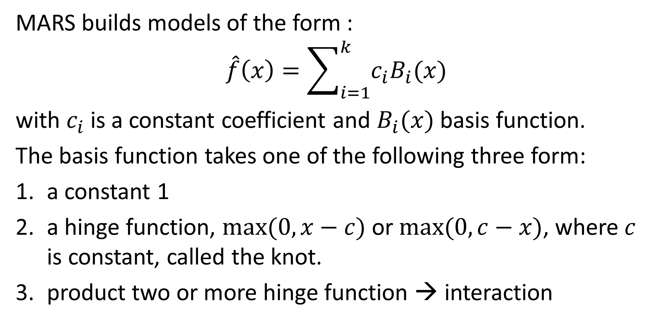
Non-Parametric : MARS (2)
MARS builds models of the form :
$$\hat{f}\left(x\right)=\sum_{i=1}^{k}{c_{i}B_{i}(x)}$$
with $c_{i}$is a constant coefficient and $B_{i}(x)$ basis function.
The basis function takes one of the following three form:
a constant 1
a hinge function, $max⁡(0,x−c)$ or $max⁡(0,c−x)$, where $c$ is constant, called the knot.
product two or more hinge function → interaction

Slide 50
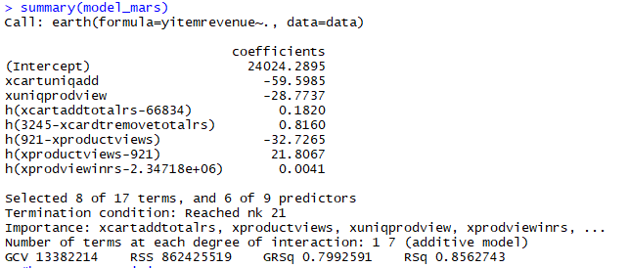
Case Study- Relationship between product revenue and user behavior
MARS model
library(earth)
model_mars=earth(yitemrevenue~.,data=data)
summary(model_mars)
Model did not need any assumption → non parametric
MARS model have higher R-Squared (0.856) than linear model (0.755)

Slide 51
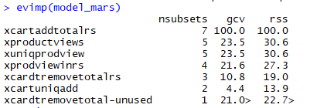
Important variable
evimp(model_mars)

Slide 52
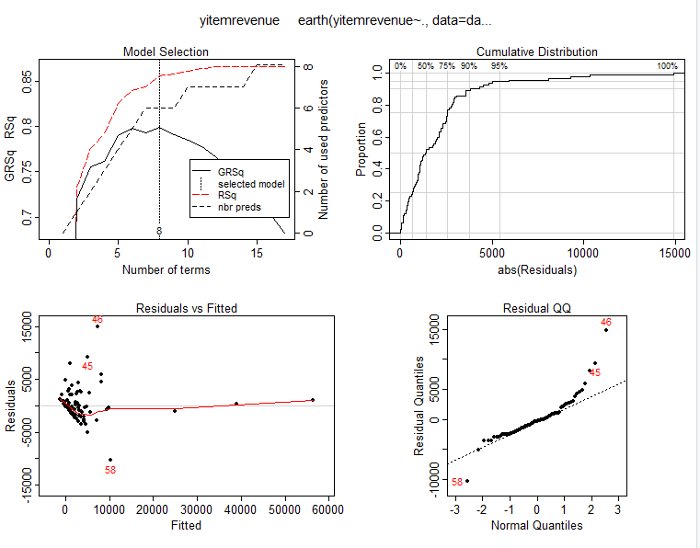
Model specification
plot(model_mars)

Slide 53
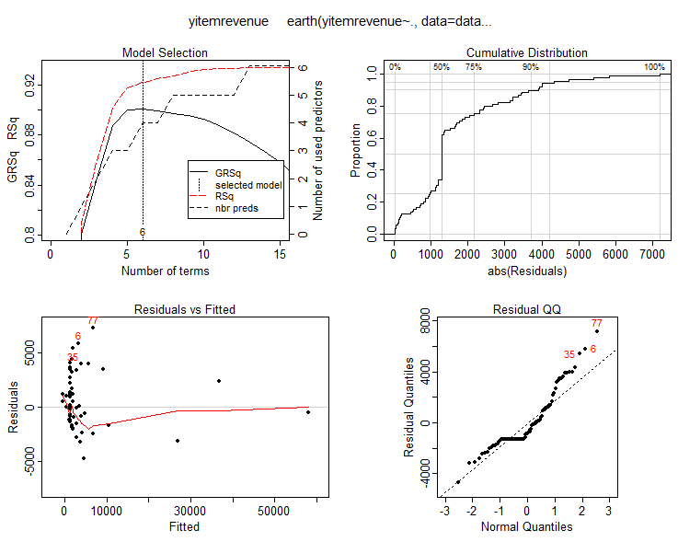
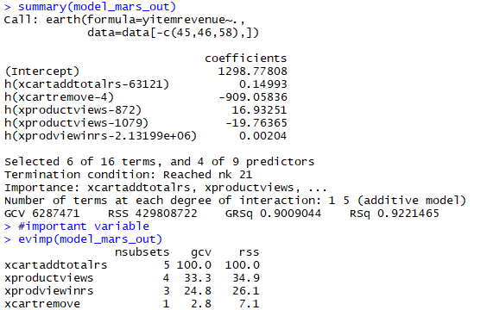
Exclude the outlier
model_mars_out=earth(yitemrevenue~.,data=data[-c(45,46,58),])
summary(model_mars_out)
#important variable
evimp(model_mars_out)
plot(model_mars_out)
We have more parsimonious model with higher R-Squared

